Slide 1

Regular Languages and Automata
Instructor: Kuan Cheng

Slide 2
How to model machines?

Slide 3
States & Inputs
State is a basic concept that all machines have
States (of the gate): Open, Close
Front pad
Rear pad
Inputs: (press) Front, Rear, Both, Neither
E.g. An automatic gate
States transit according the input!

Slide 4
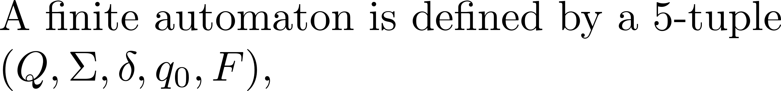



A simple model: Deterministic Finite state Automata (DFA)
A formal definition?
Front, Rear, Both
Neither
open
close
Neither
Front, Rear, Both
States\Inputs | Neither | Front | Rear | Both
Close 0 | 0 | 1 | 1 | 1
Open 1 | 0 | 1 | 1 | 1

Slide 5
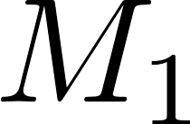

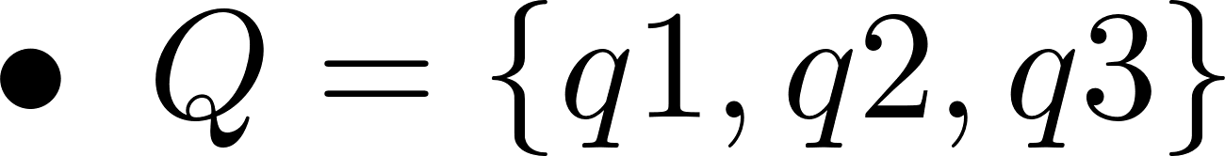
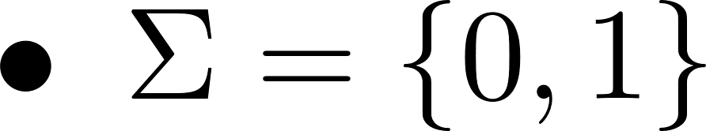
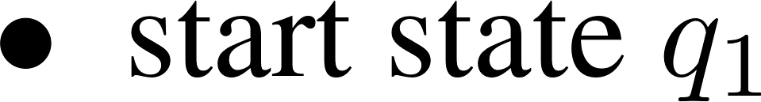
A more general example
1
0
1
0
q1
q2
q3
0, 1
States\Inputs | 0 | 0
q1 | q1 | q2
q2 | q3 | q2
q3 | q2 | q2

Slide 6
What strings are accepted?

Slide 7
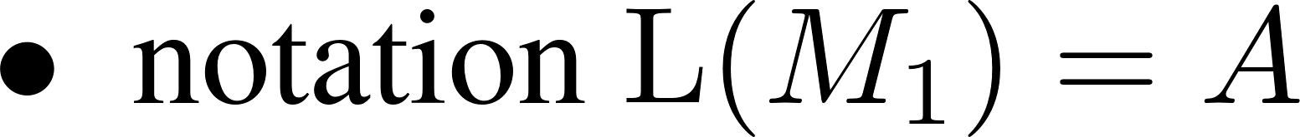
Set of strings accepted

Slide 8
Examples
1
0
1
0
q1
q2
q3
States\Inputs | 0 | 0
q1 | q1 | q2
q2 | q3 | q2
q3 | q2 | q2
0, 1

Slide 9

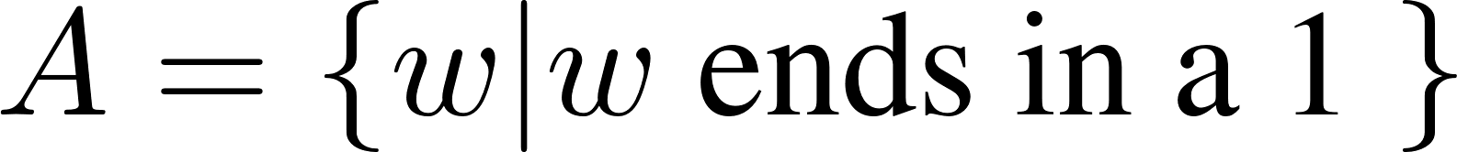
Examples
1
0
1
q1
q2
0

Slide 10
Examples
1
0
1
q1
q2
q1
0

Slide 11
Examples
s
a
b
a
q1
r1
q1
r1
b
a
b
b
a
q2
r2
b
a

Slide 12
Examples
s
a
b
a
q1
r1
q1
r1
b
a
b
b
a
q2
r2
b
a

Slide 13
Automata can do computations?

Slide 14


Definition of computation and regular language

Slide 15
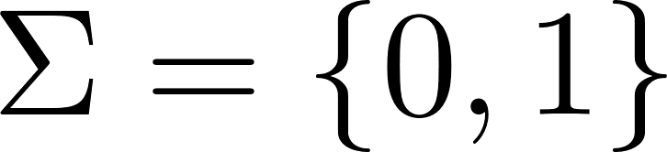
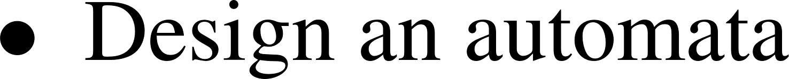
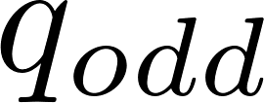
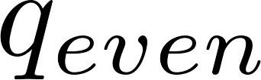
Automata Design
0
0
q1
1
1

Slide 16
Automata Design

Slide 17
Doe automatas have a boundary of computation power?

Slide 18
Detect the boundary
How to detect the boundary of computation power?
Explore how fancy the recognized language sets can be!
What does fancy mean in mathematics?
Maybe no equivalent definition but at least we can give some examples
E.g. in the sense of set operations

Slide 19


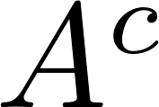

Regular Languages under Set Operations
Basic operations: union, intersection, complementation, concatenation…

Slide 20

Regular Languages under Set Operations
Basic operations: union, intersection, complementation, concatenation…

Slide 21

Regular Languages under Set Operations

Slide 22


Regular Languages under Set Operations

Slide 23
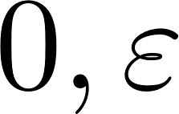
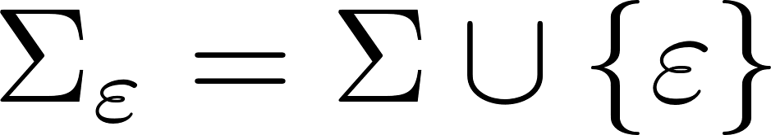
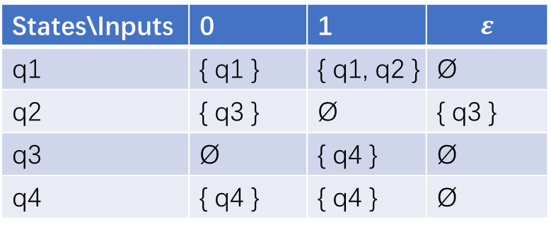
Non-deterministic Finite Automata (NFA)
0, 1
0, 1
q2
q4
q1
q3
q4
1
1
States\Inputs | 0 | 1 | $$ε$$
q1 | { q1 } | { q1, q2 } | Ø
q2 | { q3 } | Ø | { q3 }
q3 | Ø | { q4 } | Ø
q4 | { q4 } | { q4 } | Ø

Slide 24
Computation of NFA

Slide 25
Is NFA more powerful than DFA?

